Slide 1
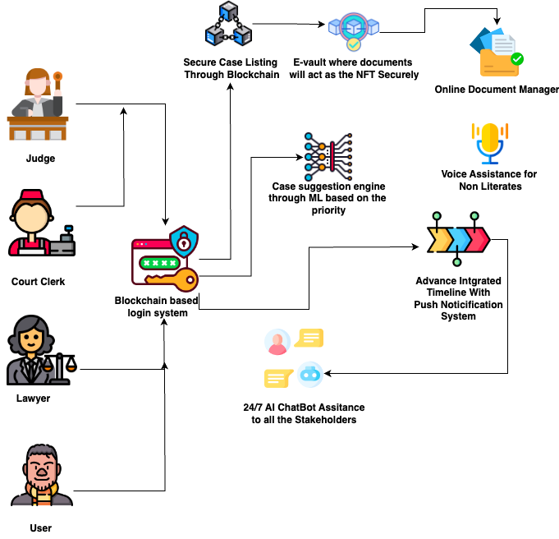
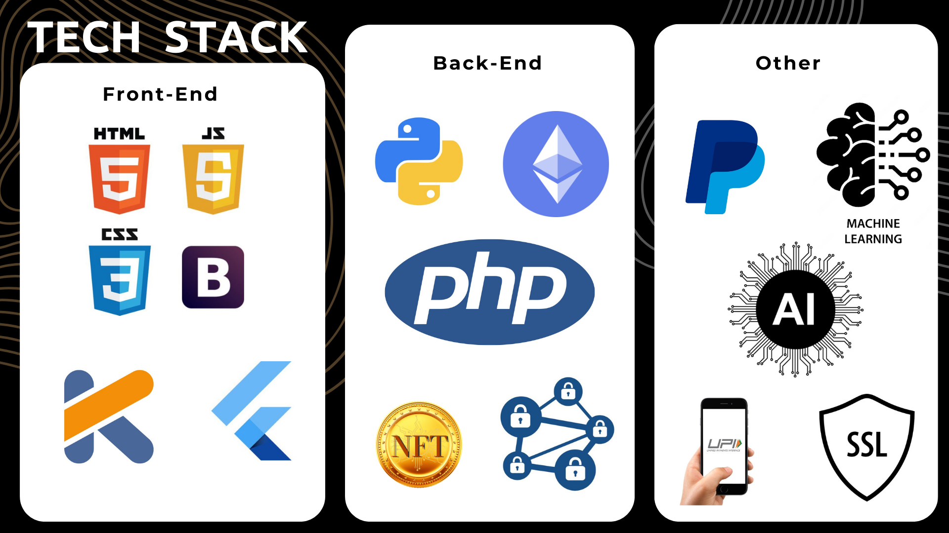
Idea/Approach Details
FLOW DIAGRAM/SYSTEM DESIGN:-
We created a solution by creating both Web-based and Android application which serves as special Automated Case Management System which will have numerous features.
Platform with four login system involving (Judges, Lawyers, Court Clerks and Clients
Providing Secure and Irreversible listing of cases with the help of Blockchain.
identifying and prioritizing the cases according to their nature, complexity, urgency Using Deep Learning Algorithm.
Digital documents management system secured by Blockchain.
Advanced Integrated Timeline and push notification system and AI generated call alerts .
Automated Scheduling System with the option for a feature to handle rescheduling and adjustments
Realtime AI Chatbot assistance available 24/7 .
NLP to extract key information from legal documents, such as contracts, pleadings, or judgments.

Slide 2

Idea/Approach Details
There will be online portals for clients, enabling them to access their case status, view upcoming hearings, communicate with their legal representatives, and upload documents securely
A platform for online alternative dispute resolution that enables parties to engage in mediation and other conflict resolution processes.
Evidence and Witness Management System Secured with End to End Encryption.
Automated Compliance Tracking system to Track Deadlines
Integrated Marketplace within the software, allowing legal professionals and users to access a marketplace of legal services.
Unique Features:-
Dependencies
Use Cases:-
A multilingual Android and Web based platform which includes more than 32 different languages
Implement an intelligent queuing system that dynamically adjusts case priorities based on the real-time workload of judges and court resources using ML
Automated case Summary Generation System using AI
Automated legal billing system to reduce corruption .
Real Time chat bot assistance available to all stakeholders of platform
Voice assistant also available for the uneducated and disabled person
Using Blockchain Technology to secure and validate digital evidence, ensuring its integrity and authenticity.
Smart ML integration for finding hot markets for specialized Marketing Strategies.
Blockchain integration and issue of digital certificates with verified user IDs to maintain a healthy supply chain
Use of Generative AI for writing case description
Use of Cloud Based Scalable Model for Smooth User Experience
Version Control System
ShowStoppers:-
New version Of ML libraries ,so Upgrade would be required
Increase of Load on Servers On increased Traffic on the Website

Slide 3
Team Details
Team Leader Parth Tiwari BE CSE 2nd Year Chandigarh University
Team Member Divyanshu Sah BE CSE 2Nd Year Chandigarh University

